Slide 1
TEAM ALPHA – ITERATION 3
Randy Charland, Allen Tshudy, chris willis, Shucheng ge, yue lei, enda peng, and vikrant sanghvi

Slide 2
agenda
Project Management (Allen and Randy)
Requirements Analysis (Tiger)
Design (Vikrant)
Implementation (Panda)
QA and Testing (Shu)
Security (Allen)
Integration (Chris)
Configuration (Randy)
Demo

Slide 3
Project Management
Team Alpha immediately assigned roles and attempted to establish quick communications
Each person on the team was assigned a lead role
PivotalTracker Project was created and used through the development process, utilizing features and bug fix stories
Two weekly meetings were formed, one during/after class and another conference call on Mondays at 8pm using Skype for Business, meeting minutes were taken at each
Slack utilized extensively for communications
Very little email communication was utilized, which was surprising

Slide 4
Development Teams
Team Alpha experimented with multiple development sub-teams for iteration #1 but went back to being a single team for iterations #2 and #3
Explicit planning of what features the team would address and minimizing anticipated conflicts was crucial
Final merges for iteration #2 and #3 occurred with no issues
Extensive communication during requirements phase helped significantly

Slide 5
Iterations
Team Alpha methodically increased complexity of project development throughout the iterations
Iteration #1 focused on creating test cases for known bugs
Iteration start and end dates
File attachment bugs
Iteration #2 focused on fixing the known bugs and adding additional features
Fixing iteration date and attachment bugs
Starting to add additional information to Project Detail
Adding a file attachment functionality on a per-story basis
Beginning work on a Backlog queue

Slide 6
Iterations (continued)
Iteration #3 finished more advanced features
Completed a Backlog queue that list stories by priority, with integration into existing Icebox and specific iterations
Created an Issue Summary within the Requirements Tool that lists issues assigned to the Project from within Issue Tracker, with direct links to the issue for details
Added additional details within the Project Detail page to provide granular status of the stories within the Project
Upgraded the project-level attachment feature to have the same functionality as the story-level attachment feature
Enabled SSL encryption on the production server with a registered X.509 certificate
Added additional Unit tests to increase code coverage within the Requirement Tool models
Added story types of “Feature”, “Bug Fix”, “Chore”, “Release”

Slide 7
Risk Management
As you can see the risk index was very high in the beginning
team work very well together and as a result we where very successful.
Risk | Impact | Probability | Retirement Plan
Limited technical background | HIGH | HIGH | Group more experience with less experienced
Time Management | HIGH | HIGH | We planned on a conservative side
Lack of communication | HIGH | HIGH | We every effort to made sure we meet twice a week.
Over estimating | HIGH | MEDIUM | We set expectations right away.

Slide 8
Risk Management Continue
Risk | Impact | Probability | Retirement Plan
Additional course work | MEDIUM | LOW | I think for some it might have been an issue.
Planning for each iteration | MEDIUM | MEDIUM | We did a good job here we ask everyone to enter stories and we would discuss at our first weekly calls.
Maintaining vs new Development | LOW | LOW | This was new to a lot of the teams members but, we did will. I think the fact that we spent the 1 iteration testing was key to our success.
Losing resources | LOW | LOW | We did loose one resource but it was the project even started

Slide 9
Requirement analysis
Overview of functional requirements using use case diagram
User stories in three iterations
Trace of tracking project requirements.
New features added.

Slide 10
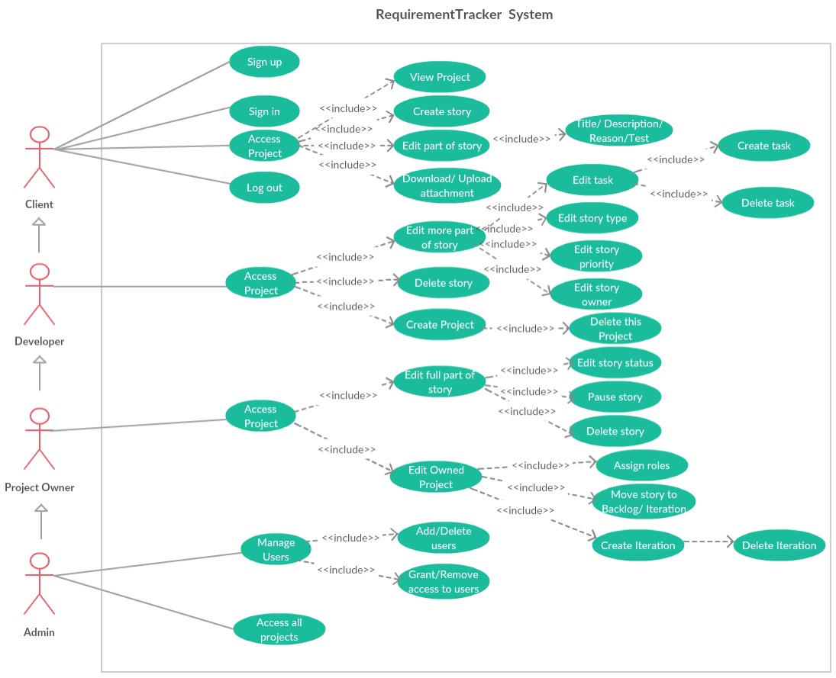

Slide 11
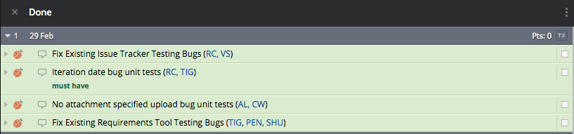
User stories in Iteration 1

Slide 12
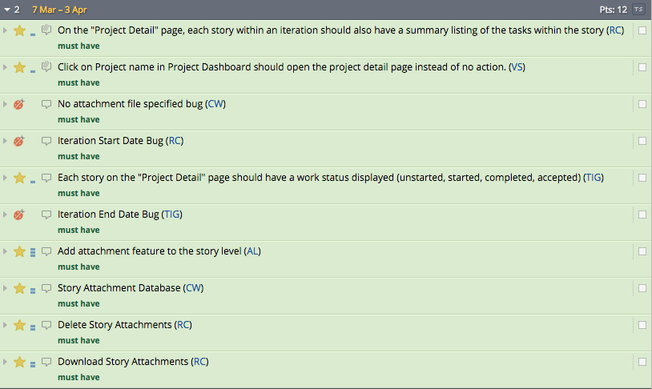
User stories in Iteration 2

Slide 13
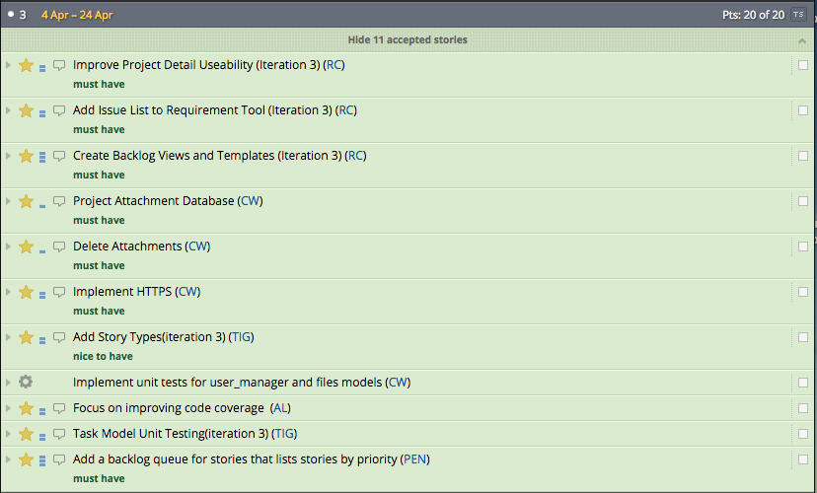
User stories in Iteration 3

Slide 14
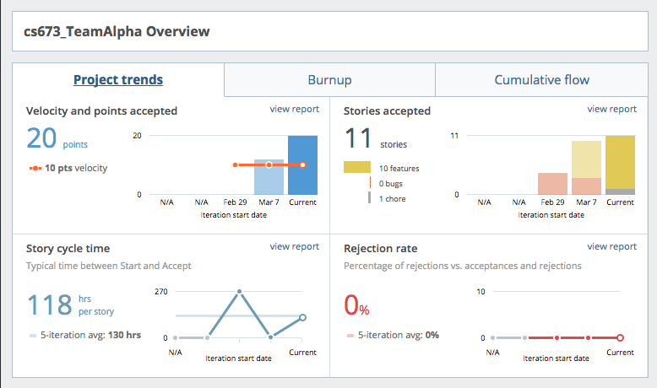
Overview of Pivotaltracker

Slide 15
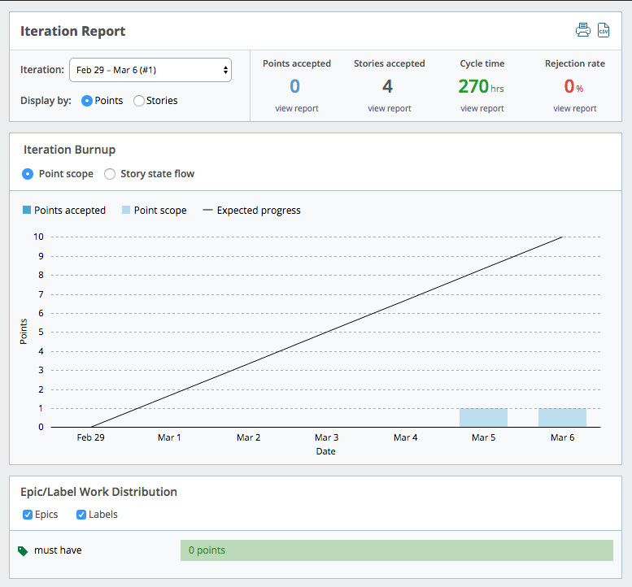
Iteration 1 Report

Slide 16
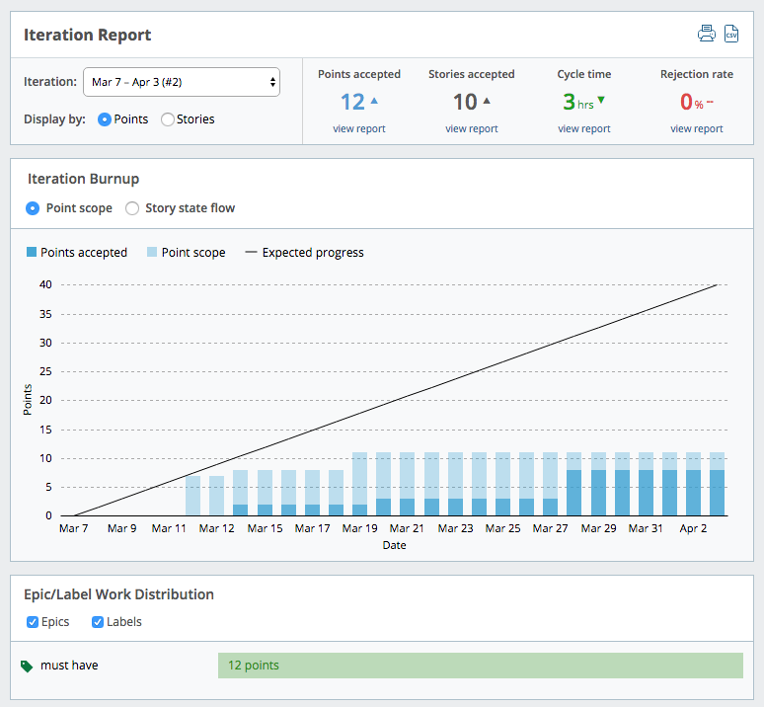
Iteration 2 Report

Slide 17
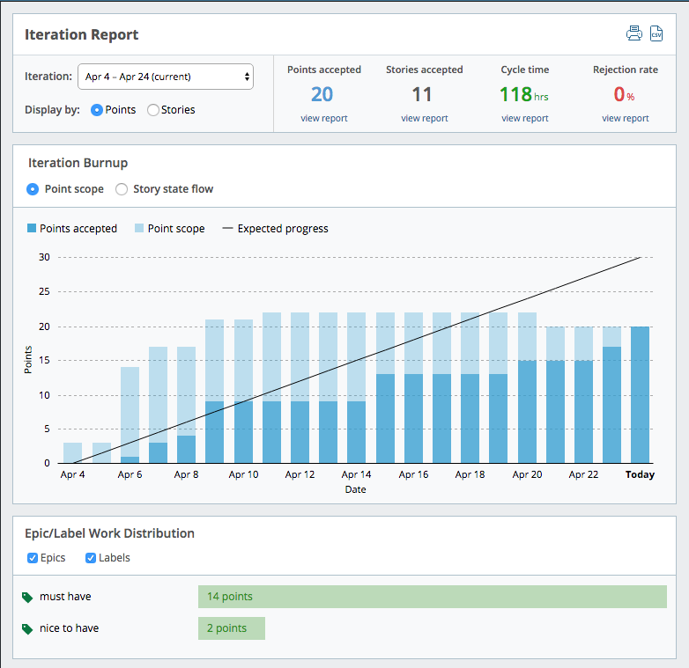
Iteration 3 Report

Slide 18
New features added
Labels | Features | Functional/ Non-Functional
Must have | Constrains on iteration date | Non-Functional
 | Upload attachment | Functional
 | Show tasks list within an iteration | Functional
 | Show project detail directly when clicking project’s name | Functional
 | Each story has a work status displayed | Non-Functional
 | Download/ Delete attachments under story | Functional
 | Add issue list to requirement tool | Functional
 | Create backlog views and templates | Functional
 | List stories in queue by priority in backlog | Functional

Slide 19
New features added
Labels | Features | Functional/ Non-Functional
Nice to have | Add story type(Bug/ feature/ Chore) | Functional
 | Add attachment feature to story level | Functional
 | Remodel database | Non-Functional
 | Improve project detail usability | Non-Functional
 | Implement HTTPS | Non-Functional
 | Constrains for story & project level attachment | Non-Functional

Slide 20
Design
Design Goals
Software Architecture
Model –Entities Diagram
View
Templates –view relationship
Design patterns
Key Algorithms

Slide 21
Design Goals
Increase Understandability over functionality
Reusability over Information hiding(maintainability) (maximize cohesion and minimize coupling
Sufficiency over Efficiency
Integration with other team

Slide 22
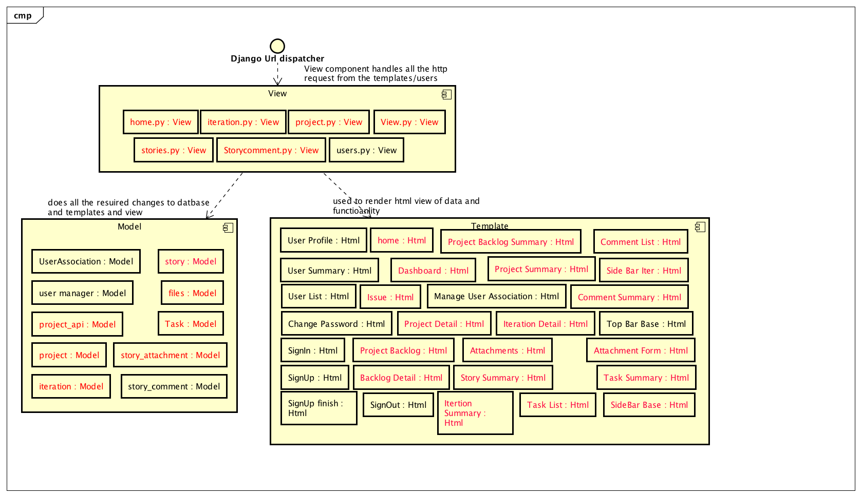
Software Architecture
Using the existing software architecture with new additions:

Slide 23
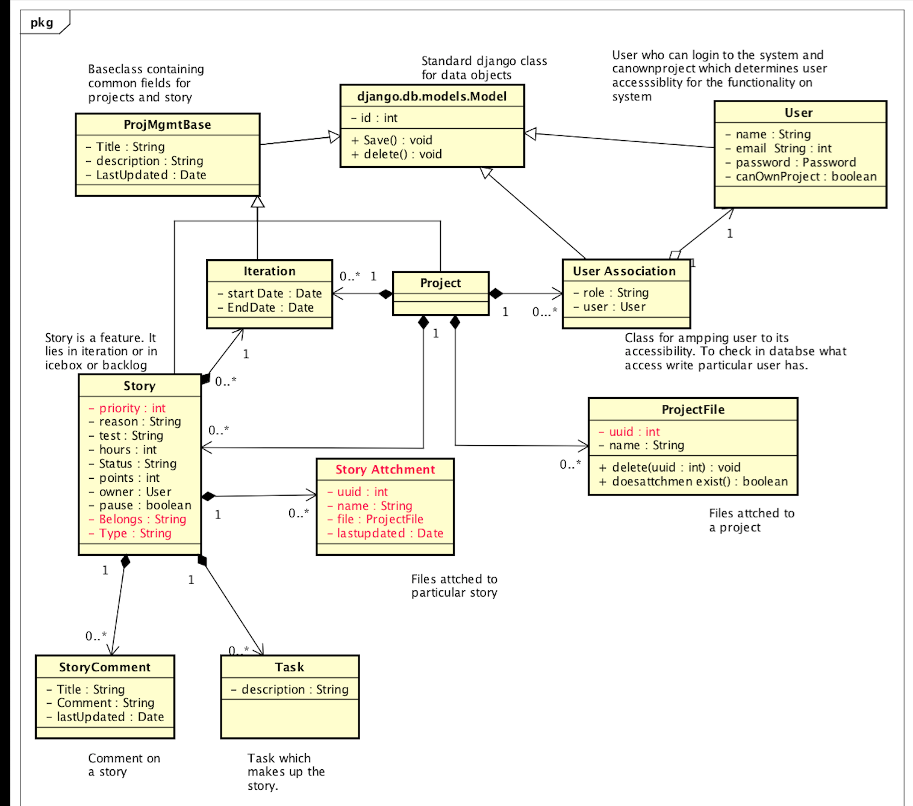
Model Entities Diagram
Model - The model component contains modules for entities and apis for accessing those entities.

Slide 24
Model Entities Diagram
Each entity class is stored as a table in the database created and maintained by the django model ORM layer
Entities are exposed to outside components through api python modules which contain methods for creating and working with entities.
The following diagram shows the api modules as well as the entity classes they depend on.

Slide 25
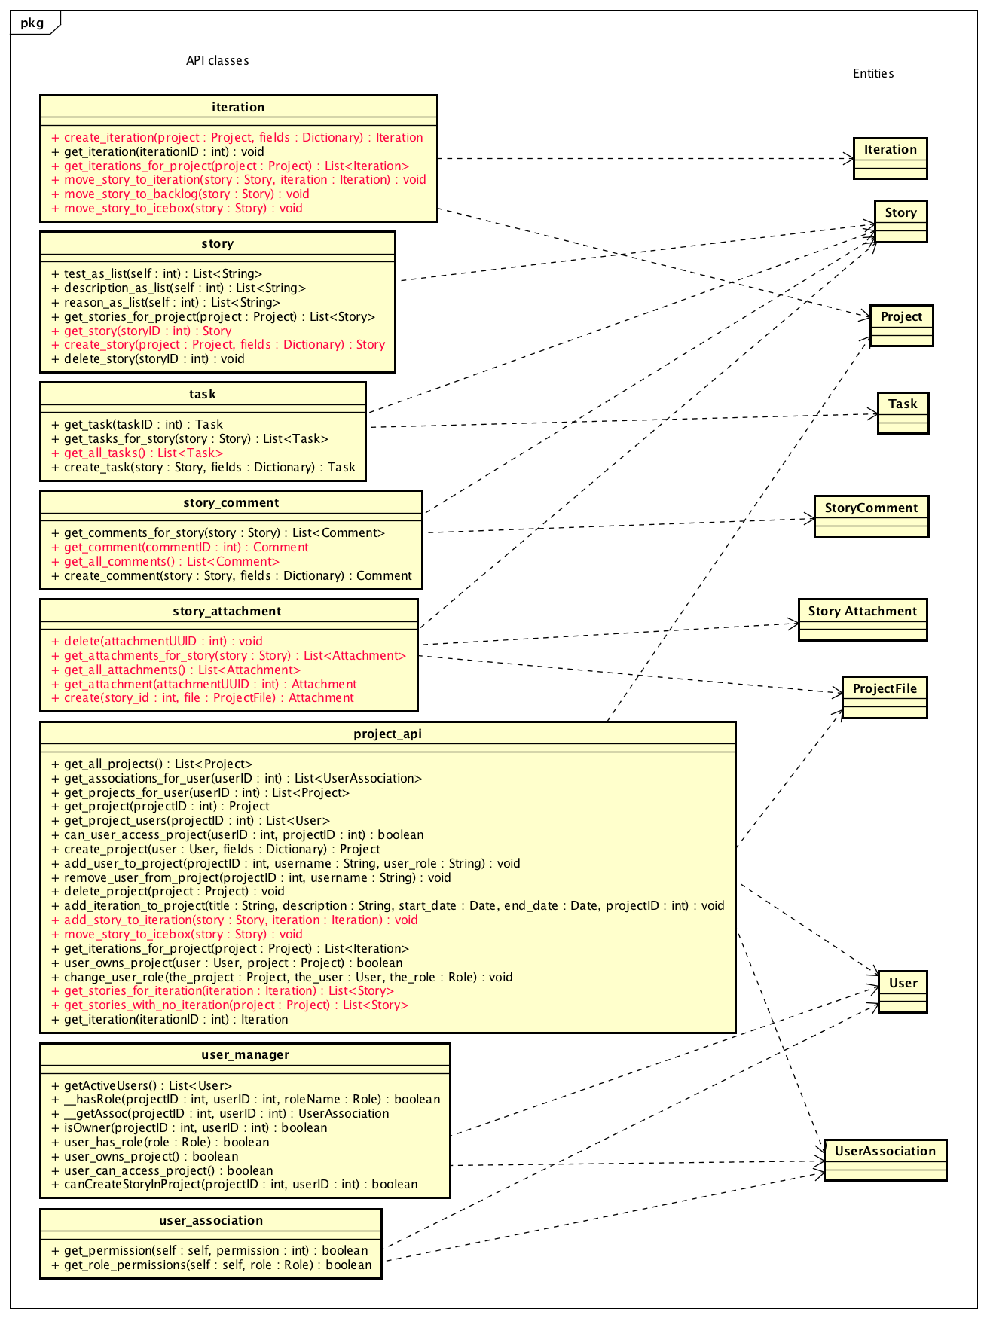

Slide 26
View
The view component contains the functionality for processing http requests, working with the model layer to read/write data and using the templates to render html.
Views are functions in django module that taken in a http request and optional http url parameters and return http responses.

Slide 27
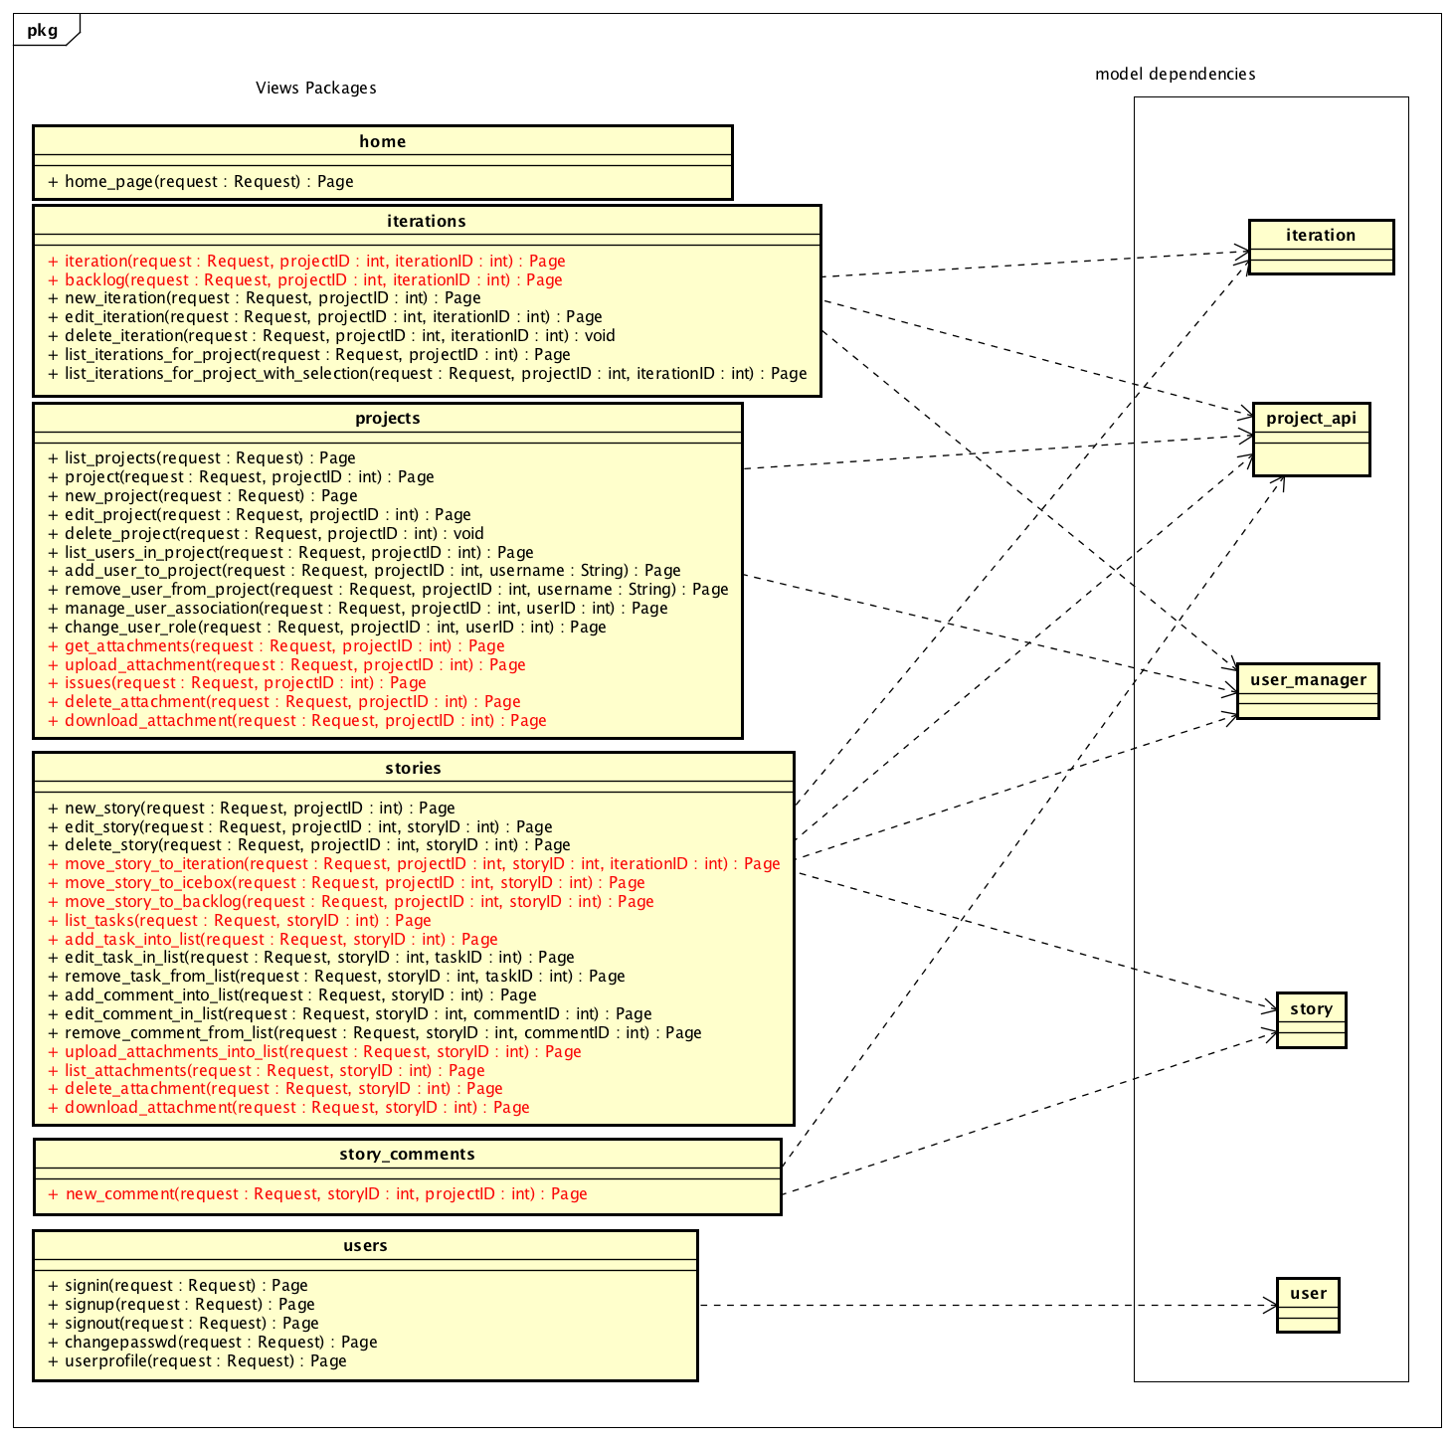

Slide 28
Template –view Relationship
Templates are used by the views to render html responses.
The following diagram shows the view classes and the templates they depend on.

Slide 29
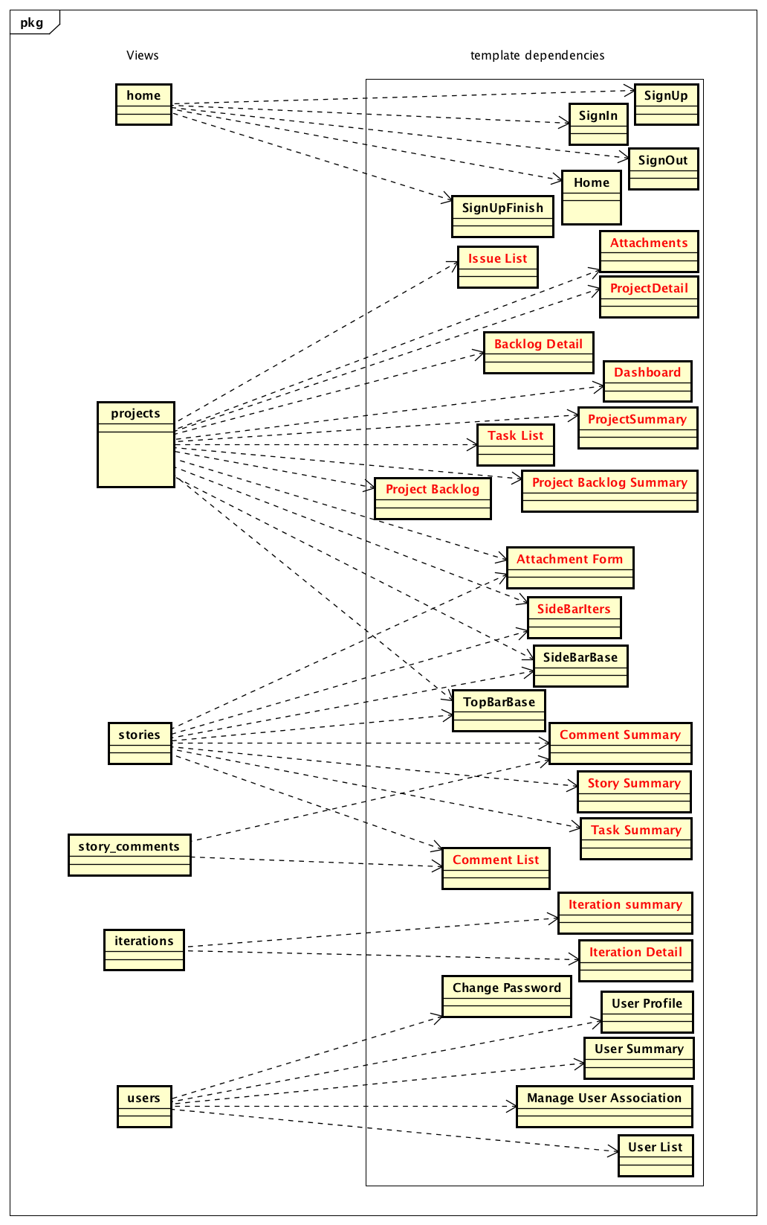

Slide 30
Design Pattern
Primary design Pattern: Model View Template
Factory pattern to create entities
Api classes expose create methods used to generate entities
This pattern allows our project to have a single location where an entity of a certain type can be generated.
It also gives us flexibility for future extensibility.
If the requirements of our system change and we need to change implementing class for a certain entity we can modify the factory method to return a different type that maintains the behavior of the original class.
This would give us the desired behavior change without requiring changes to other classes in the system.

Slide 31
Design Pattern
REST
REST is an architectural style that abstracts data management to HTTP requests.
Data access, creation, updates, and delete are all available via the corresponding HTTP verb.
This enabled our application to still use the Django modeling system, while allowing other components of the application access to the same data.
The HTTP status code of the response allowed us to ensure that data was being managed properly

Slide 32
Key Algorithms
User Permission:
When creating a project we need to make sure that the user has the permission to create a project.
When editing a story we need to check the UserAssociation linking the user and project and make sure it contains the correct role.
Story Attachment :
When attaching a file to the story, we need to check whether user has access to do it and sees if the uuid gets generated for the file attached.

Slide 33
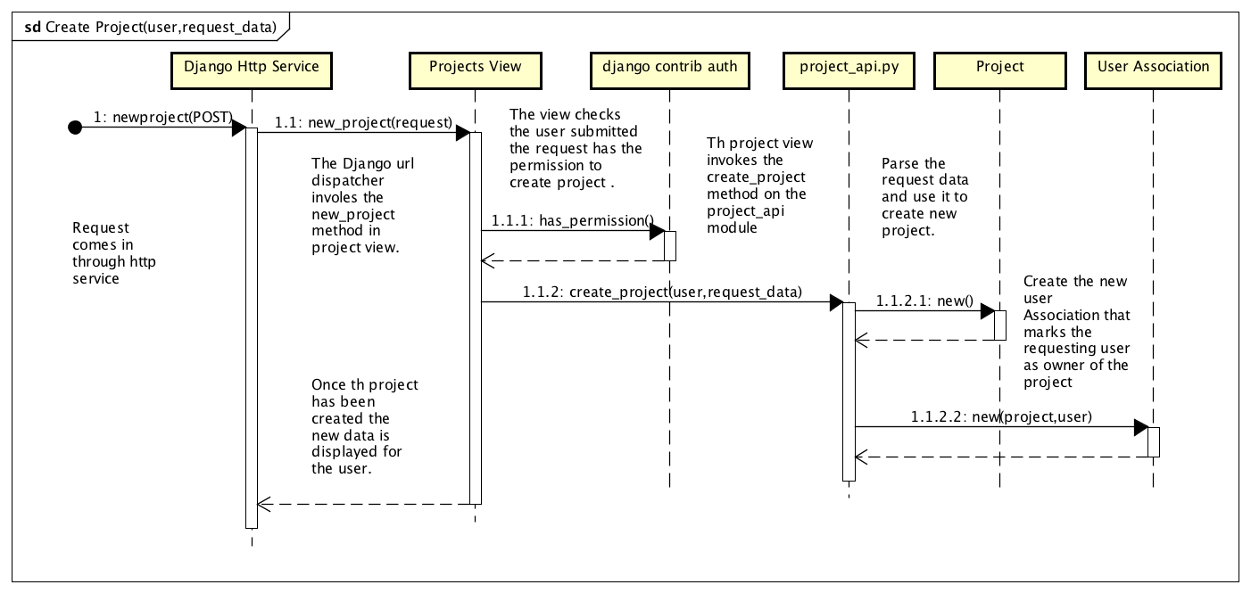
Create new project

Slide 34
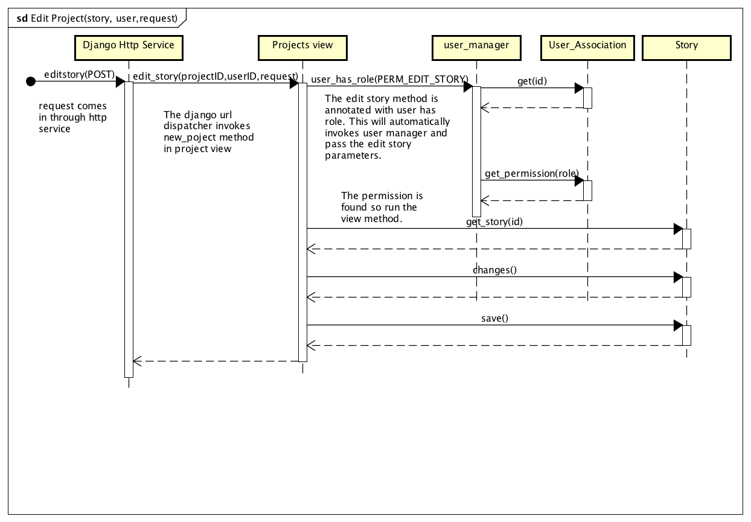
Edit story

Slide 35
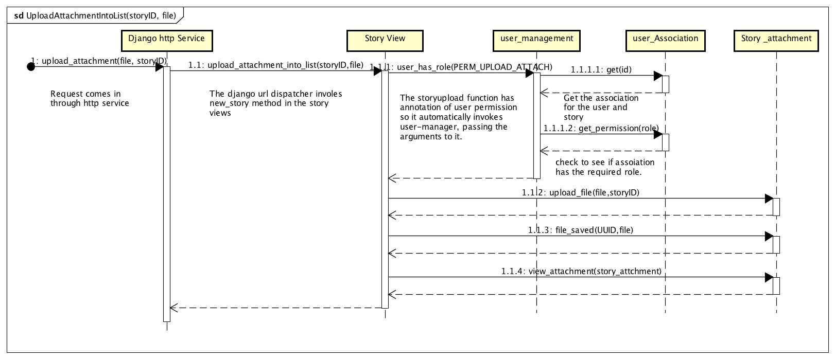
Upload_attachment

Slide 36
Reference
https://github.com/CS673S15-Group1/Final_Project (for existin project design )
Astah software designing tool: http://astah.net/features/uml-features

Slide 37
Implementation
Bug Repair
Issue tracker testing bug:
Before: Unable to launch unit test
Now: Do unit test correctly and can generate report
Iteration date bug:
Before: End date could be earlier than start date
Now: Don’t allowed
No attachment specify bug
Before: Could pass the unit test and raise nothing.
Now: raise dialog to stop user.

Slide 38
Implementation
Application Architecture
Iss

Slide 39
Implementation
New features
HTTP → HTTPS : Now our website supports HTTPS
Attachment management: Attachment could be viewed on project level.
Backlog: Newly added backlog module
Story: Story now supported priority and type. We can browse our attachment by project
Move Stories: Stories can be moved between Ice Box, backlog and iteration.
Add Issue list to requirement tool
Add backlog queue for stories that lists stories by priority

Slide 40
Quality Assurance and Testing
Code reviews were performed
Quality Metrics were gathered
Unit test: A software testing method by which individual units of source code, sets of one or more computer program modules together with associated control data, usage procedures, and operating procedures, are tested to determine whether they are fit for use.
selenium test: Selenium is a portable software testing framework for web applications. It imitates users’ operations on websites

Slide 41
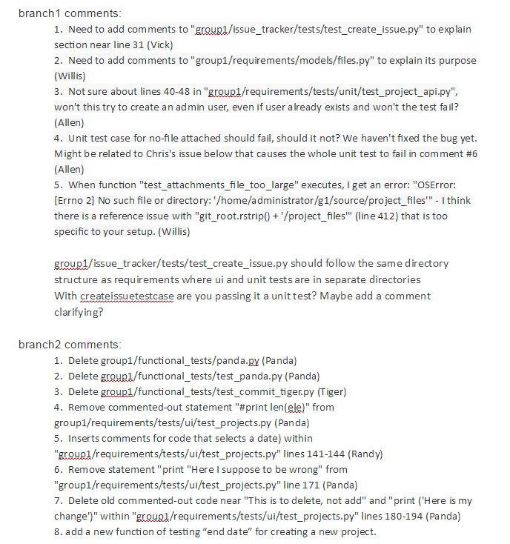
Code Reviews

Slide 42
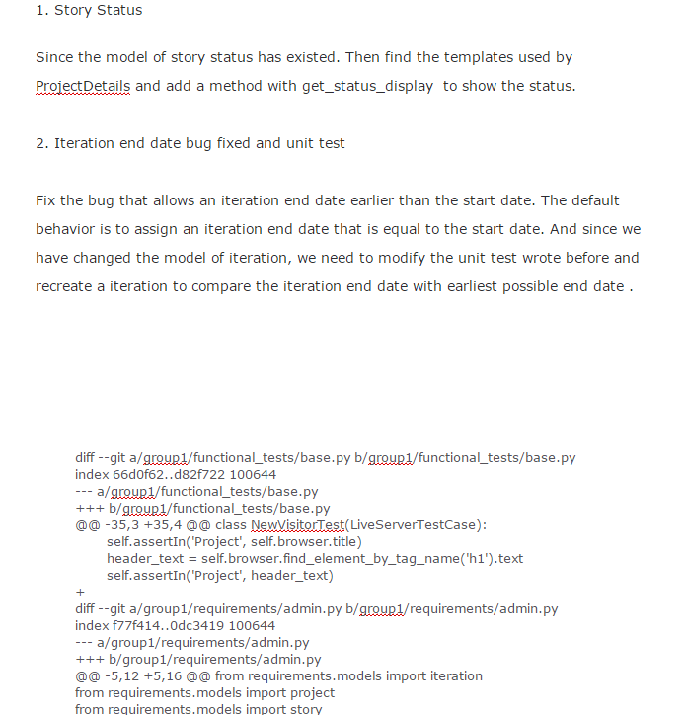
Code Reviews (continued)

Slide 43
Quality Assurance Metrics
Iteration 1
4 bugs were logged in pivotalTracker
3 bugs were logged in Slack
Total of 7 bugs where fixed
Iteration 2
3 bugs were logged in pivoltalTracker
8 bugs were logged in Slack
Total of 11 bugs where fixed
3 refactors
Iteration 3
5 bugs were logged in Slack
Total of 5 bugs were fixed
1 refactor

Slide 44
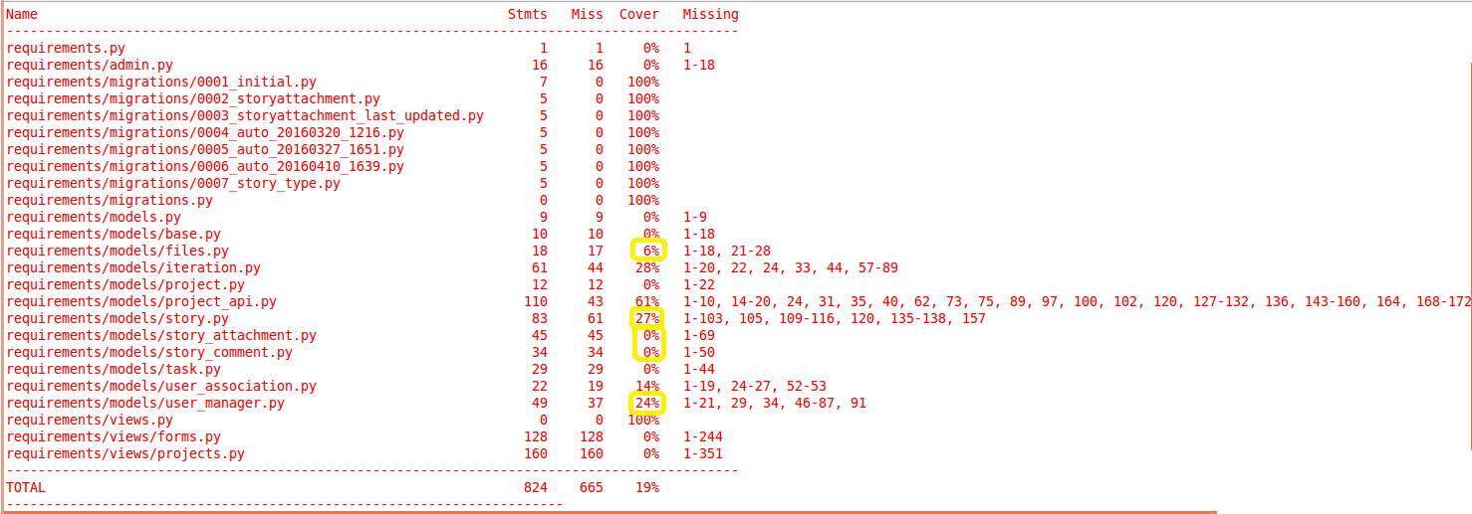
Coverage report in the beginning of Iteration 3

Slide 45
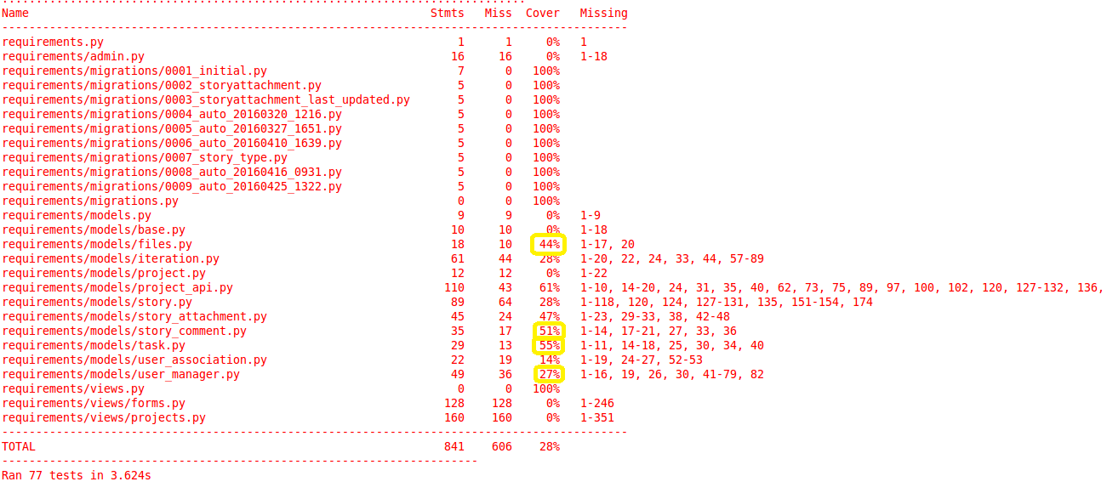
The latest coverage report

Slide 46
Overall Test Coverage
Junit test coverage report before
Screenshot image of report
19% coverage
Junit test coverage report after
Added tests for testing story_comments model
Added test for testing story_attachments model
Added test for testing tasks model
Added test for testing files model
Added test for testing user_manager model
Added a total of 17 new tests
Screen shot image of report
28% increased coverage by 9%

Slide 47
Security
OWASP Top 10
The Open Web Application Security Project top 10 web application security flaws.
Top ten list started in 2003 and is updated every 3 years
There are 3 basic categories
The Big 3
Authentication
Authorization

Slide 48
Security
 | Django 1.8 |  | 2015 Top 10 | 2007 Top 10 | Category
1 | Django's object-relational mapper (ORM) layer. Write code instead of SQL. URL mapper. Uses regex. | ▲1 | Injection | Cross-Site Scripting (XSS) | Big 3
2 | Django's sessionMiddleware - prevents any session data to be in the URL. | ▲5 | Broken Authentication and Session Management | Injection | Authentication
3 | Django's template based automatically escapes all variables. Any string values should be striped of html tags use strip_tags(). | ▼2 | Cross-Site Scripting (XSS) | Malicious File Execution | Big 3
4 | Django defines a special field called ‘slug’. Slugs allow for URLs & limits the usage of passing of IDs as GET parameters. |  | Insecure Direct Object References | Insecure Direct Object References | Authentication
5 | Lock down the debug option and make sure to comment out the debug tool application if it’s used. Do third party scans. Hailstorm is a tool. | ▲1 | Security Misconfiguration | Cross-Site Request Forgery | Authorization

Slide 49
More on Security
 | Django 1.8 |  | 2015 Top 10 | 2007 Top 10 | Category
6 | In our case passwords are probably the only data that needs to be secure. Django has AuthenticationMiddleware uses SHA256 hash | ▲2 | Sensitive Data Exposure | Information Leakage and Improper Error Handling | Authorization
7 | View are setup using django’s permission architecture. |  | Missing Function Level Access Control | Broken Authentication and Session Management | Authorization
8 | Django has a Cross-Site Request Forgery middleware which is active by default. This forces you to include a {%csrf_token%} tag within the <form> elements when posting a form to a django web site. | ▼3 | Cross-Site Request Forgery | Insecure Cryptographic Storage | Big 3
9 | <This is on developers they should not be using updated componets> |  | Using Components with Known Vulnerabilities | Insecure Communications | Authorization
10 | URL mapper configures all links to views in Django. |  | Unvalidated Redirects and Forwards | Failure to Restrict URL Access | Authentication

Slide 50
References on Security
https://www.stealthbits.com/company/blog/article/item/121-the-owasp-top-10-then-and-now
https://www.owasp.org/index.php/Top_10_2007
https://docs.djangoproject.com/en/1.9/

Slide 51
Integration Environment
Created a standard Ubuntu 14.04.3 LTS OVA VM template with the following software installed:
Eclipse | 3.8.1
PyDev Eclipse plug-in | 4.5.4.201601292234
EGit Eclipse plug-in | 4.2.0.201601211800
Python | 2.7.6
Django | 1.6.1
VMware Workstation/Fusion | 12.1.0/8.1

Slide 52
Configuration
Private Github repository created within the first week of class
Private repository chosen to ensure no one outside of the development team could inadvertently change or delete project code (our grades counted on it!)
Username and password authentication along with SSL used for security
Github code diffs used during code reviews
Each iteration utilized development branches which were then merged into the Master branch
Naming convention: Devteam<number>-Iteration<number>
Iteration #1 had two development branches, iterations #2 and #3 utilized only a single development branch each
Github merging (“New Pull Request”) function used to merge iteration branches into Master branch at the end of the iteration

Slide 53
Lessons Learned
Communication and planning is key
Many issues with merging and conflicts successfully mitigated with planning
It is hard to replace in-person meetings with virtual ones
Communicating requirement use-cases with sufficient detail can be challenging
Test driven development can be difficult in practice
Hard to not go directly into development when short on time
The agile method of using iterations works
Provides evidence of progress and breaks up a large project into manageable chunks
As is often the case in the commercial industry, security can take second place to completing functionality on time

Slide 54
DEMO

Slide 55
File Attachments
Primary contributors: Allen Tshudy, Chris Willis, Randy Charland
Attachments can now be downloaded and deleted from the story level
Project-level attachment code has been refactored
Attachments can now be deleted from the project level
Story and project-level attachments are stored on the file system with UUIDs and mapped to original names in DB

Slide 56
Project Backlog
Primary contributors: Randy Charland, Enda Peng, Tiger Lei
There is a Backlog to add stories prior to moving a story to an iteration
Stories are listed in priority order within the Backlog, from highest priority to lowest priority
Stories now have a priority that can be assigned (Low, Medium, High)
Stories now have a story type that be assigned (Feature, Bug Fix, Chore, Release)

Slide 57
Dashboard and Project Detail Enhancements
Primary contributors: Randy Charland, Vikrant Sanghvi, Tiger Lei
Clicking on projects with the Dashboard bring you directly to the project
Additional information is shown on the Project Detail page to include
Status of a story
Summary of story attributes
Listing of tasks
Listing of comments
Listing of attachments

Slide 58
Issue Tracker Integration
Primary contributors: Randy Charland
There is a function to view all issues entered within Issue Tracker that belong to a particular project
A summary of issues is listed within Project Detail
There is a detailed listing within the Project that allows a user to go directly to the issue within Issue Tracker
Intended to be used in conjunction with new story types

Slide 59
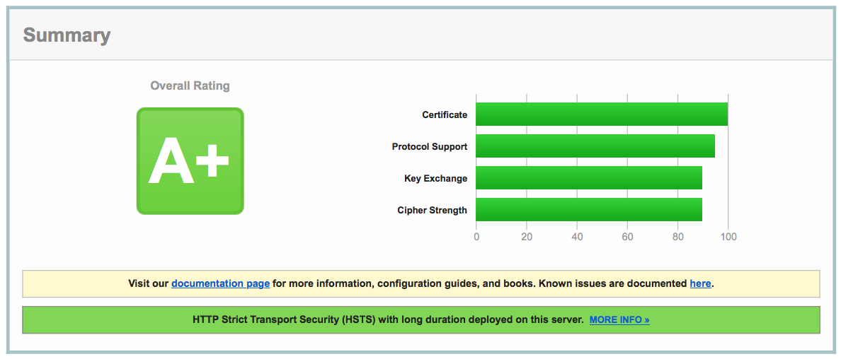
SSL
Primary contributors: Chris Willis
Operational BU virtual machine is now configured to utilized SSL
A registered certificate was obtained from “Let’s Encrypt”
Registered an A+ on Qualys SSL Report
Going to HTTP port automatically redirects to SSL

Slide 60
Unit Testing
Primary contributors: Allen Tshudy, Chris Willis, Randy Charland, Tiger Lei, Vikrant Sanghvi, Enda Peng
Increased code coverage by creating unit tests for:
File attachment features and bugs
Iteration start and end dates
Requirement Tool models
Backlog feature

